Slide 1
Bent Grass Metropolitan District Annual Meeting
Thursday, February 6th, 2025
Falcon Fire Station #3
7020 Old Meridian Road

Slide 2
Agenda
Introductions/Call To Order
What is a Metro District?
District Manager Report
Board Director Report – Erin Ganaway
Board President Report – Randle Case II
Q&A

Slide 3
What is a Metropolitan District?

Slide 4
A form of local government that helps facilitate the construction of public infrastructure in new development and redevelopment, such as roads, curb/gutter, parks, and water infrastructure
Function within the constraints provided by county and state laws and regulations
The developer requests money up front in the form of bonds in order to provide the improvements and is paid back through the collection of property tax revenue through an approved Service Plan

Slide 5
District Manager Report
2025 budget
2024 year-end unaudited financial statements
2025 landscaping plans
Current Bond Status

Slide 6
2025 Budget – General Fund

Slide 7
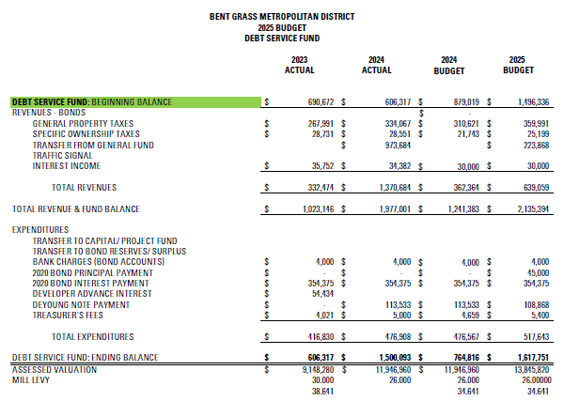
2025 Budget– Debt Fund

Slide 8
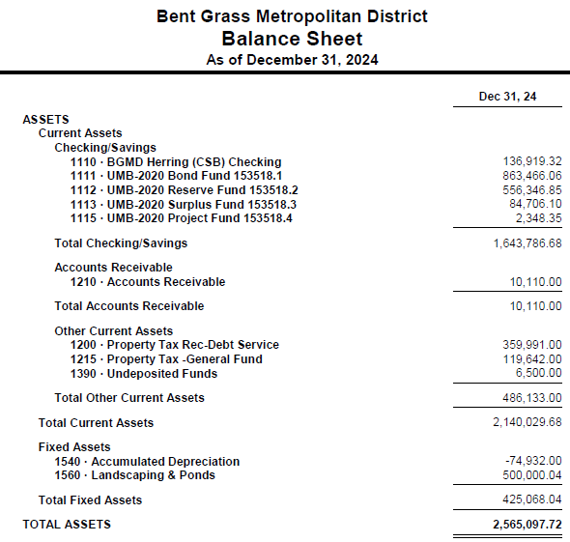
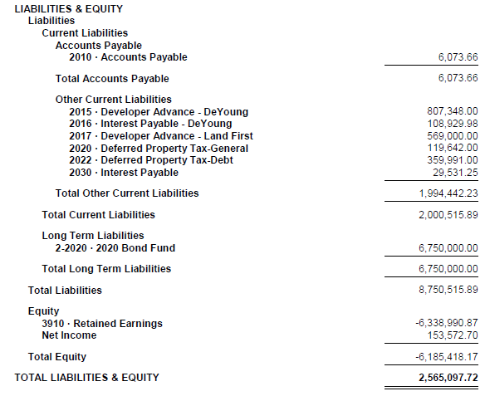
2024 Year-End Financials

Slide 9
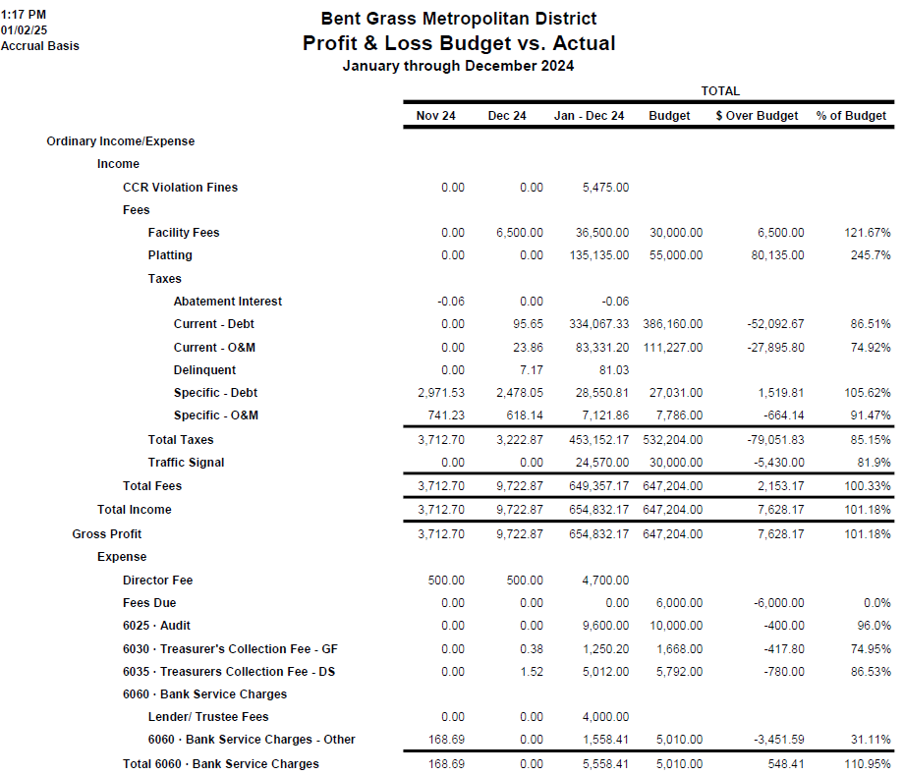
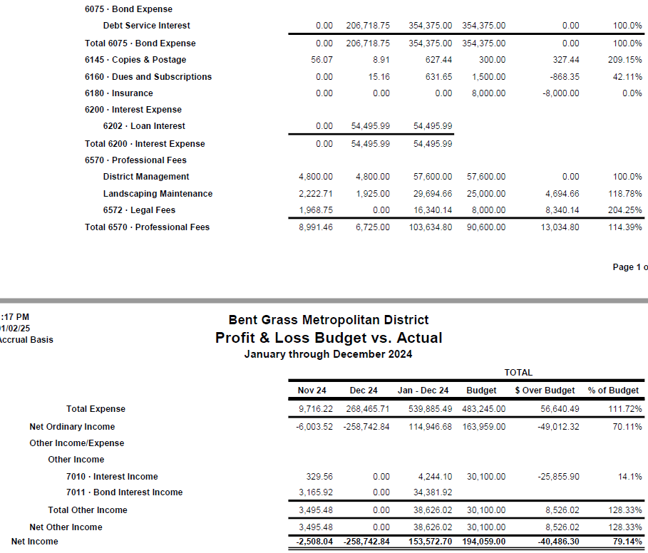
2024 Year-End Financials (Cont.)

Slide 10
2025 Landscaping Plans
Review of potential landscaping bids
Bent Grass Meadows Drive xeriscape conversion
Additional maintenance areas (Filing No. 2)
“Pocket Park” discussion

Slide 11
Current Bond Status
Bond Amounts | Lender/Trustee | Interest Rate | Issued | BALANCE AS OF 12/31/2024
$6,750,000 | UMB BANK |  |  | 6,750,000.00
Issued: 2020
Maturity Date: Dec. 1, 2049 (refinance being considered) |  | 5.25% | 6/30/2020
Operations & Maintenance Mill Levy 8.641 | Debt Service Mill Levy 26.000
How to Calculate your Property Taxes:
Market Value of your home X (times) Residential Assessment Rate (RAR) = Assessed Valuation (AV) AV x (times) Mill Levy Rate ÷ (divided by) 1,000 = Annual Property Tax | EXAMPLE: Home Value is $300,000 $300,000 x 6.7% (current RAR) = $20,100 (AV) 20,100 x 34.641 (current mill levy) = 696,2874.10 ÷ 1,000 = $696.28 per year

Slide 12
Board Director Report – Erin Ganaway

Slide 13
Board President Report – Randle Case II

Slide 14
Q & A
Homeowner Q&A will be limited to three (3) minutes per owner

Slide 15
THANK YOU!
Adam Noel, District Manager
719-453-1297
adam.n@wsdistricts.co
bentgrassmd.colorado.gov

