Slide 1
Bent Grass Metropolitan District
2023 Status

Slide 2
Structure of the District
District
Elected/Appointed Board of Directors
Professional Management by WSDM District Managers
Legal support as needed
Auditors

Slide 3
Operational Expenses
Directors are Volunteers
Management expenses include
Billing
Mailing
Accounting
Website
Special District compliance filings and other requirements
Customer interactions
Account transfer
Legal expenses include
Support as needed
Auditors
Insurance

Slide 4
Current Public Infrastructure Projects
There are currently no Public Infrastructure Projects

Slide 5
Current Bond Status
BENT GRASS METROPOLITAN DISTRICT
Bond Amounts | Lender/Trustee | Interest Rate | Issued | BALANCE AS OF 12/31/2023
$6,750,000 | UMB BANK |  |  | 6,750,000.00
Issued: 2020
Maturity Date: Dec. 1, 2049 (refinance being considered) |  | 5.25% | 6/30/2020

Slide 6
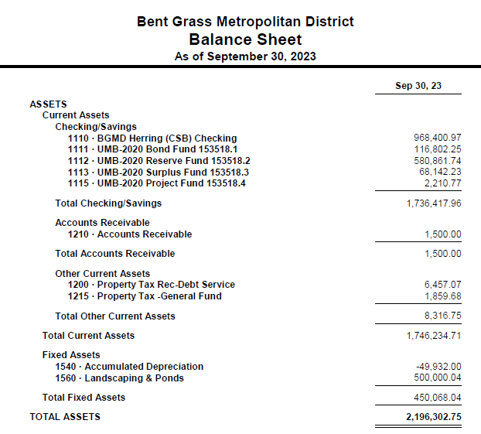
Unaudited Financial Statements Balance Sheet- As of September 30, 2023

Slide 7
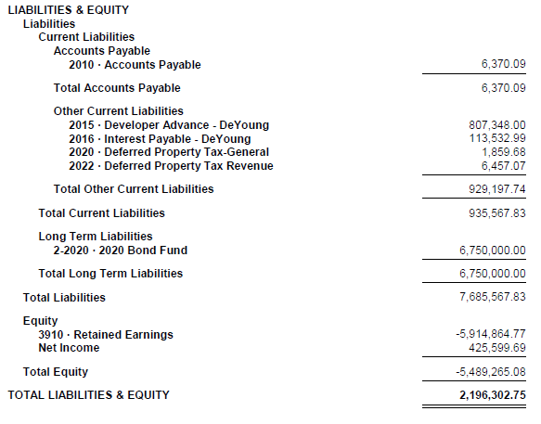
Balance Sheet- As of September 30, 2023 (CONT’D)

Slide 8
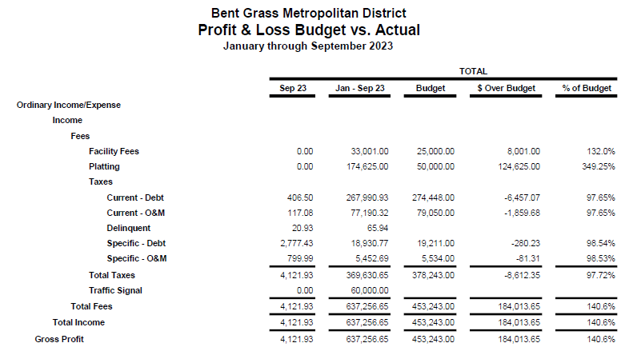
Unaudited Financial Statements Profit & Loss 2023 Budget vs. Actual – As of September 30, 2023

Slide 9
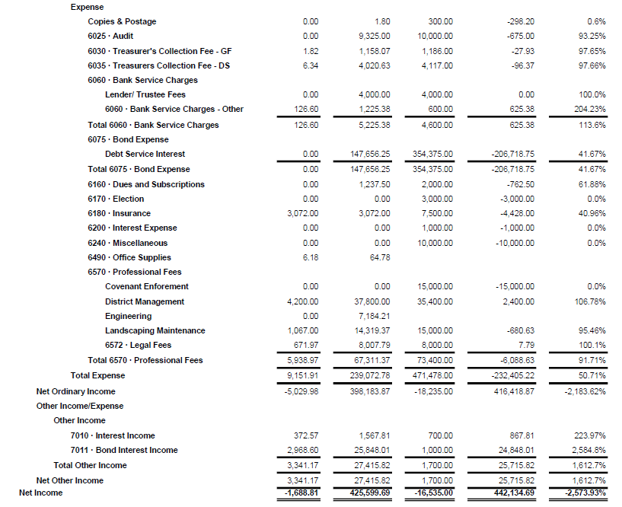
Profit & Loss 2023 Budget vs. Actual – As of September 30, 2023 (CONT’D)

Slide 10
Questions?

